Slide 1
FEDERATED LEARNING

Slide 2
OUTLINE OF THE TALK
What is Federated Learning?
A baseline algorithm: FedAvg
Some challenges in Federated Learning
Wrapping up
1

Slide 3
WHAT IS FEDERATED LEARNING?

Slide 4
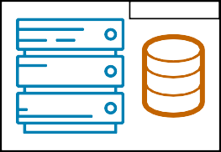










A SHIFT OF PARADIGM: FROM CENTRALIZED TO DECENTRALIZED DATA
The standard setting in Machine Learning (ML) considers a centralized dataset processed in a tightly integrated system
But in the real world data is often decentralized across many parties
data center
≠
2

Slide 5



WHY CAN’T WE JUST CENTRALIZE THE DATA?
Sending the data may be too costly
Self-driving cars are expected to generate several TBs of data a day
Some wireless devices have limited bandwidth/power
Data may be considered too sensitive
We see a growing public awareness and regulations on data privacy
Keeping control of data can give a competitive advantage in business and research
3

Slide 6
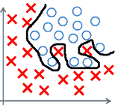
HOW ABOUT EACH PARTY LEARNING ON ITS OWN?
The local dataset may be too small
Sub-par predictive performance (e.g., due to overfitting)
Non-statistically significant results (e.g., medical studies)
The local dataset may be biased
Not representative of the target distribution
4

Slide 7
A BROAD DEFINITION OF FEDERATED LEARNING
Federated Learning (FL) aims to collaboratively train a ML model while keeping the data decentralized
5

Slide 8





A BROAD DEFINITION OF FEDERATED LEARNING
Federated Learning (FL) aims to collaboratively train a ML model while keeping the data decentralized
initialize model
5

Slide 9





A BROAD DEFINITION OF FEDERATED LEARNING
Federated Learning (FL) aims to collaboratively train a ML model while keeping the data decentralized
each party makes an update using its local dataset
5

Slide 10
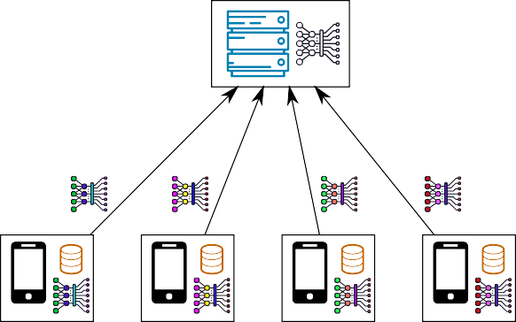
A BROAD DEFINITION OF FEDERATED LEARNING
Federated Learning (FL) aims to collaboratively train a ML model while keeping the data decentralized
parties share local updates for aggregation
5

Slide 11
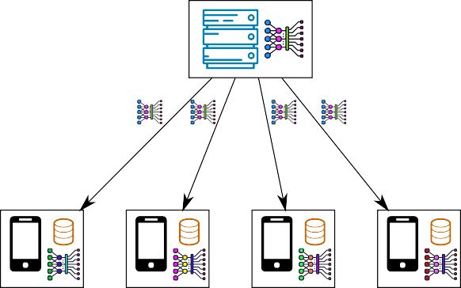
A BROAD DEFINITION OF FEDERATED LEARNING
Federated Learning (FL) aims to collaboratively train a ML model while keeping the data decentralized
server aggregates updates and sends back to parties
5

Slide 12





A BROAD DEFINITION OF FEDERATED LEARNING
Federated Learning (FL) aims to collaboratively train a ML model while keeping the data decentralized
parties update their copy of the model and iterate
We would like the final model to be as good as the centralized solution (ideally), or at least better than what each party can learn on its own
5

Slide 13
KEY DIFFERENCES WITH DISTRIBUTED LEARNING
Data distribution
In distributed learning, data is centrally stored (e.g., in a data center)
The main goal is just to train faster
We control how data is distributed across workers: usually, it is distributed uniformly at random across workers
In FL, data is naturally distributed and generated locally
Data is not independent and identically distributed (non-i.i.d.), and it is imbalanced
Additional challenges that arise in FL
Enforcing privacy constraints
Dealing with the possibly limited reliability/availability of participants
Achieving robustness against malicious parties
...
6

Slide 14
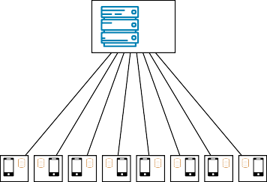
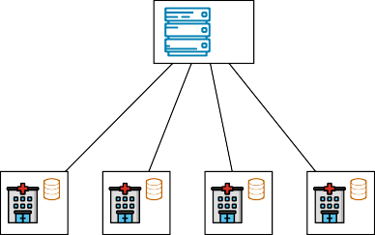
CROSS-DEVICE VS. CROSS-SILO FL
Cross-device FL
Cross-silo FL
Massive number of parties (up to 10¹⁰)
Small dataset per party (could be size 1)
Limited availability and reliability
Some parties may be malicious
2-100 parties
Medium to large dataset per party
Reliable parties, almost always available
Parties are typically honest
7

Slide 15
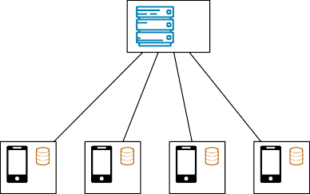
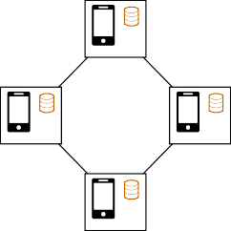
SERVER ORCHESTRATED VS. FULLY DECENTRALIZED FL
Server-orchestrated FL
Fully decentralized FL
Server-client communication
Global coordination, global aggregation
Server is a single point of failure and may become a bottleneck
Device-to-device communication
No global coordination, local aggregation
Naturally scales to a large number of devices
8

Slide 16
FEDERATED LEARNING IS A BOOMING TOPIC
2016: the term FL is first coined by Google researchers; 2020: more than 1,000 papers on FL in the first half of the year (compared to just 180 in 2018)¹
We have already seen some real-world deployments by companies and researchers
Several open-source libraries are under development: PySyft, TensorFlow Federated, FATE, Flower, Substra...
FL is highly multidisciplinary: it involves machine learning, numerical optimization, privacy & security, networks, systems, hardware...
This is all a bit hard to keep up with!
¹https://www.forbes.com/sites/robtoews/2020/10/12/the-next-generation-of-artificial-intelligence/
9

Slide 17
A BASELINE ALGORITHM: FEDAVG

Slide 18
BASIC NOTATIONS
We consider a set of K parties (clients)
Each party k holds a dataset D_{k} of n_{k} points
Let D = D₁ ∪ · · · ∪ D_{K} be the joint dataset and n = ^{Σ}_{k} n_{k} the total number of points
We want to solve problems of the form min_{θ∈R}p F(θ; D) where:
K
Σ Σ
n
k
F(θ; D) =
F (θ; D ) and F (θ; D ) = f
(θ; d)
n
k
k
k k
k=1 d∈D_{k}
θ ∈ R^{p} are model parameters (e.g., weights of a logistic regression or neural network)
This covers a broad class of ML problems formulated as empirical risk minimization

Slide 19
FEDAVG (AKA LOCAL SGD) [MCMAHAN ET AL., 2017]
Algorithm FedAvg (server-side)
Algorithm ClientUpdate(k, θ)
Parameters: client sampling rate ρ
initialize θ
for each round t = 0, 1, . . . do
S_{t} ← random set of m = ⌈ρK⌉ clients
Parameters: batch size B, number of local steps L, learning rate η
for each local step 1, . . . , L do
B ← mini-batch of B examples from D_{k}
Σ
n
θ ← θ − η
∇f(θ; d)
for each client k ∈ S in parallel do
k
t
B d∈B
θ_{k} ← ClientUpdate(k, θ)
send θ to server
Σ
n_{k θk}
θ ←
k∈S n
t
For L = 1 and ρ = 1, it is equivalent to classic parallel SGD: updates are aggregated and the model synchronized at each step
For L > 1: each client performs multiple local SGD steps before communicating

Slide 20

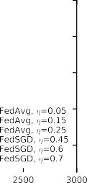

FEDAVG (AKA LOCAL SGD) [MCMAHAN ET AL., 2017]
FedAvg with L > 1 allows to reduce the number of communication rounds, which is often the bottleneck in FL (especially in the cross-device setting)
It empirically achieves better generalization than parallel SGD with large mini-batch
Convergence to the optimal model can be guaranteed for i.i.d. data [Stich, 2019] [Woodworth et al., 2020] but issues arise in strongly non-i.i.d. case (more on this later)
12

Slide 21
FULLY DECENTRALIZED SETTING
We can derive algorithms similar to FedAvg for the fully decentralized setting, where parties do not rely on a server for aggregating updates
Let G = ({1, . . . , K}, E) be a connected undirected graph where nodes are parties and an edge {k, l} ∈ E indicates that k and l can exchange messages
Let W ∈ [0, 1]^{K×K} be a symmetric, doubly stochastic matrix such that W_{k,l} = 0 if and only if {k, l} ∈/ E
Given models Θ = [θ₁, . . . , θ_{K}] for each party, WΘ corresponds to a weighted aggregation among neighboring nodes in G:
Σ
[WΘ] = W θ , where N_{k} = {l : {k, l} ∈ E}
k k,l l
l∈N_{k}
13

Slide 22
FULLY DECENTRALIZED (LOCAL) SGD [LIAN ET AL., 2017, KOLOSKOVA ET AL., 2020B]
Algorithm Fully decentralized SGD (run by party k)
Parameters: batch size B, learning rate η, sequence of matrices W^{(t)}
initialize θ⁽⁰⁾
k
for each round t = 0, 1, . . . do
B ←₁ mini-batch of B examples from D_{k}
(t+ ) (t) _{n}
Σ
θ ← θ − η
(t)
2
k
∇f(θ ; d)
k
k B d∈B₁
k
Σ
_{W}(t)_{θ}(t+ ₂ )
(t+1)
θ ←
k
l∈N
(t)
k,l l
k
Decentralized SGD alternates between local updates and local aggregation
Doing multiple local steps is equivalent to choosing W^{(t)} = I_{n} in some of the rounds
The convergence rate depends on the topology (the more connected, the faster)
14

Slide 23
SOME CHALLENGES IN FEDERATED LEARNING
1. DEALING WITH NON-I.I.D. DATA

Slide 24
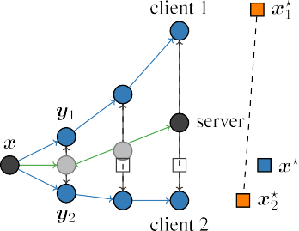


CLIENT DRIFT IN FEDAVG
(Figure taken from [Karimireddy et al., 2020])
When local datasets are non-i.i.d., FedAvg suffers from client drift
To avoid this drift, one must use fewer local updates and/or smaller learning rates, which hurts convergence

Slide 25
THEORETICAL CONVERGENCE RATES FOR FEDAVG
Analyzing the convergence rate of FL algorithms on non-i.i.d. data involves some assumption about how the local cost functions F₁, . . . , F_{k} are related
For instance, one can assume that there exists constants G ≥ 0 and B ≥ 1 such that
K
1
K
Σ
∀θ :
2 2 2 2
∥∇F (θ; D )∥ ≤ G + B ∥∇F(θ; D)∥
k k
k=1
FedAvg without client sampling reaches ϵ accuracy with O( ¹ + ^{G} + ^{B2} ), which is
_{ϵ}3/2
KLϵ² ϵ
slower than the O( ¹ ₂ + ¹ ) of parallel SGD with large batch [Karimireddy et al., 2020]
KLϵ ϵ

Slide 26
SCAFFOLD: CORRECTING LOCAL UPDATES [KARIMIREDDY ET AL., 2020]
Algorithm Scaffold (server-side)
Algorithm ClientUpdate(k, θ, c)
Parameters: client sampling rate ρ, global learning rate η_{g}
initialize θ, c = c₁, . . . , c_{K} = 0
for each round t = 0, 1, . . . do
S_{t} ← random set of m = ⌈ρK⌉ clients
for each client k ∈ S_{t} in parallel do
Parameters: batch size B, # of local steps L, local learning rate η_{l}
Initialize θ_{k} ← θ
for each local step 1, . . . , L do
B ← mini-batch of B examples from D_{k}
Σ
θ ← θ − η (
n
k
∇f(θ; d) − c_{k} + c)
k k l
B d∈B
(∆θ_{k}, ∆c_{k}) ← ClientUpdate(k, θ,c)
+
1
c ← c − c + (θ − θ )
Σ
k k
k Lη_{l}
θ ← θ +
c ← c +
η
∆θ_{k}
+
g
send (θ − θ, c − c ) to server
Σ
k
k
k
m k
∈St
1
K k∈S
∆c
c ← c
+
k
t
k k
Correction terms c₁, . . . , c_{K} approximate an ideal unbiased update
Can show convergence rates which beat parallel SGD

Slide 27
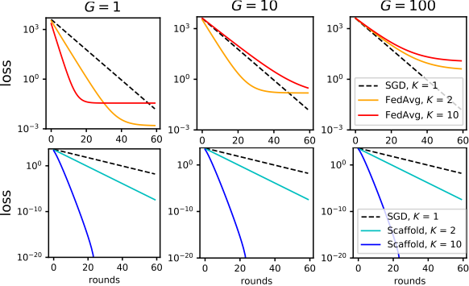
SCAFFOLD: CORRECTING LOCAL UPDATES [KARIMIREDDY ET AL., 2020]
FedAvg becomes slower than parallel SGD for strongly non-i.i.d. data (large G)
Scaffold can often do better in such settings
Other relevant approach: FedProx [Li et al., 2020b]

Slide 28
FEDERATED LEARNING OF PERSONALIZED MODELS
Learning from non-i.i.d. data is difficult/slow because each party wants the model to go in a particular direction
If data distributions are very different, learning a single model which performs well for all parties may require a very large number of parameters
Another direction to deal with non-i.i.d. data is thus to lift the requirement that the learned model should be the same for all parties (“one size fits all”)
Instead, we can allow each party k to learn a (potentially simpler) personalized model θ_{k} but design the objective so as to enforce some kind of collaboration

Slide 29
PERSONALIZED MODELS FROM A “META” MODEL
[Hanzely et al., 2020] propose to regularize personalized models to their mean:
Σ Σ
Σ
1
K K
¨
1
K
K
¨
2
F(θ₁, . . . , θ_{K}; D) = _{K}
F_{k}(θ_{k}; D_{k}) + ^{λ} ¨θ −
2K
θ
¨
k
l
k=1 k=1 l=1
Inspired by meta-learning, [Fallah et al., 2020] propose to learn a global model which easily adapts to each party:
K
1
K
Σ
F(θ; D) =
F_{k}(θ − α∇F_{k}(θ); D_{k})
k=1
These formulations are actually related to each other (and to the FedAvg algorithm)
Other formulations exist, see e.g., the bilevel approach of [Dinh et al., 2020]

Slide 30
PERSONALIZED MODELS VIA TASK RELATIONSHIPS
Inspired by multi-task learning, [Smith et al., 2017, Vanhaesebrouck et al., 2017] propose to regularize personalized models using (learned) relationships between tasks:
K
1
K
Σ Σ
F(θ , . . . , θ , W; D) =
F (θ ; D ) + W ∥θ − θ ∥
2
1 K
k k k k,l k l
k=1 k<l
This formulation naturally lends itself to alternating optimization schemes
It is also well suited to the fully decentralized setting, since W can be seen as a graph of relationships over parties [Vanhaesebrouck et al., 2017]
[Zantedeschi et al., 2020] propose to learn W to be a sparse graph of relationships and exchange messages only between pairs of related parties when updating the models

Slide 31
SOME CHALLENGES IN FEDERATED LEARNING
2. PRESERVING PRIVACY

Slide 32
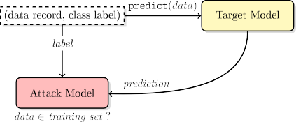
PRIVACY ISSUES IN (FEDERATED) ML
ML models are susceptible to various attacks on data privacy
Membership inference attacks try to infer the presence of a known individual in the training set, e.g., by exploiting the confidence in model predictions [Shokri et al., 2017]
Reconstruction attacks try to infer some of the points used to train the model, e.g., by differencing attacks [Paige et al., 2020]
Federated Learning offers an additional attack surface because the server and/or other clients observe model updates (not only the final model) [Nasr et al., 2019]
22

Slide 33





DIFFERENTIAL PRIVACY IN A NUTSHELL
random coins
random coins
x₁ x₂
A(D)
x₁ x'₂
A(D')
Randomized algorithm
A
Randomized algorithm
A
.
.
.
x_{n}
.
x_{n}
distribution of A(D)
distribution of A(D')
Definition ([Dwork et al., 2006], informal)
A is ε-differentially private (DP) if for all neighboring datasets
D = {x₁, x₂, . . . , x_{n}} and D′ = {x₁, x₂′ , x₃, . . . , x_{n}} and all sets S:
Pr[A(D) ∈ S] ≤ e^{ε} Pr[A(D′) ∈ S].
probability
ratio bounded
output range of A
23

Slide 34

TWO SETTINGS: CENTRALIZED VS DECENTRALIZED
Individuals
(or organizations)
Trusted
curator
Centralized setting (also called global
x₁
x₂
A
setting or trusted curator setting): A is differentially private wrt dataset D
A(D)
.
.
x
n
Individuals
(or organizations)
Untrusted
curator
Decentralized/federated setting (also called local setting or untrusted cura- tor setting): each R_{k} is DP wrt record x_{k} (or local dataset D_{k})
x₁
x₂
A
R₁ y₁
_{R} y₂
y_{n}
.
.
2
A(Y)
x_{n}
R
n
24

Slide 35
A KEY FUNCTIONALITY: DP AGGREGATION
Most (server-orchestrated) FL algorithms follow the same high-level pattern:
for t = 1 to T do
At each party k: compute θ_{k} ← LOCALUPDATE(θ, θ_{k}), send θ_{k} to server
Σ
At server: compute θ ←
1
θ , send θ back to the parties
K k
k
Differentially private federated learning algorithms can thus be designed from a differentially private aggregation primitive and the composition property of DP
In other words, given a private value x_{k} for each party k, we want to accurately
Σ
avg 1
estimate x =
x under a DP constraint
K k
k
25

Slide 36
APPROACHES TO DP AGGREGATION
A standard approach in DP to add Gaussian noise calibrated to the sensitivity of the private value (and to the strength of the desired DP guarantee)
In the decentralized setting, a baseline approach is to have each party k add the noise directly to x_{k} [Duchi et al., 2013]
Unfortunately, the resulting average has poor accuracy unless K is very large: for a fixed privacy guarantee, the gap with the centralized setting is of O(√K)
Cryptographic primitives such as secure aggregation [Bonawitz et al., 2017] and secure shuffling [Balle et al., 2019] can be used to close this gap
However their practical implementation poses important challenges when K is large
26

Slide 37
A SIMPLER PROTOCOL FOR DP AGGREGATION: GOPA [SABATER ET AL., 2020]
Algorithm GOPA protocol
1. All neighbors {k, l} in G generate
2 2
+
Parameters: graph G, variances σ , σ ∈ R
∆ η
pairwise-canceling Gaussian noise
for all neighboring parties {k, l} in G do
2
Each party k generate independent Gaussian noise
Party k reveals the sum of private value, pairwise and independent noise terms
k and l draw y ∼ N(0, σ )
∆
set ∆_{k,l} ← y, ∆_{l,k} ← −y
for each party k do
2
k draws η ∼ N(0, σ )
k
η
Σ
k reveals ˆx ← x +
∆k,l ^{+ η}k
k k
l∼k
Σ
avg
1
K k ∆
ˆx =
2
ˆx can match the accuracy of the centralized setting (for sufficient σ )
k
By choosing an appropriate graph G, each party communicates with only O(log K)
other parties
The approach is robust to collusions and drop outs (to some extent)
27

Slide 38
WRAPPING UP

Slide 39
SOME OTHER INTERESTING TOPICS IN FL
Going beyond empirical risk minimization formulations: tree-based methods
[Li et al., 2020a], online learning [Dubey and Pentland, 2020], Bayesian learning...
Vertical data partitioning, where parties have access to different features about the same examples [Patrini et al., 2016]
Compressing updates to reduce communication [Koloskova et al., 2020a]
Fairness in FL [Mohri et al., 2020, Li et al., 2020c, Laguel et al., 2020]
Security in FL: how to mitigate poisoning attacks [Bagdasaryan et al., 2020] [Blanchard et al., 2017], how to make local computation verifiable [Sabater et al., 2020]

Slide 40
KEEPING UP WITH ADVANCES IN FEDERATED LEARNING
Survey paper: Advances and Open Problems in FL [Kairouz et al., 2019]
A large collaborative effort (50+ authors!)
Should be updated by the end of the year
Online seminar: Federated Learning One World (FLOW)
https://sites.google.com/view/one-world-seminar-series-flow/
Co-organized with D. Alistarh, V. Smith and P. Richtárik, started in May 2020
Weekly talks (usually on Wednesdays, 1pm UTC) covering all aspects of FL
The videos and slides of all previous talks are available online

Slide 41
REFERENCES I
[Bagdasaryan et al., 2020] Bagdasaryan, E., Veit, A., Hua, Y., Estrin, D., and Shmatikov, V. (2020).
How To Backdoor Federated Learning.
In AISTATS.
[Balle et al., 2019] Balle, B., Bell, J., Gascón, A., and Nissim, K. (2019).
The Privacy Blanket of the Shuffle Model.
In CRYPTO.
[Blanchard et al., 2017] Blanchard, P., Mhamdi, E. M. E., Guerraoui, R., and Stainer, J. (2017).
Machine learning with adversaries: Byzantine tolerant gradient descent.
In NIPS.
[Bonawitz et al., 2017] Bonawitz, K., Ivanov, V., Kreuter, B., Marcedone, A., McMahan, H. B., Patel, S., Ramage, D., Segal, A., and Seth, K. (2017).
Practical Secure Aggregation for Privacy-Preserving Machine Learning.
In CCS.
[Dinh et al., 2020] Dinh, C. T., Tran, N. H., and Nguyen, T. D. (2020).
Personalized Federated Learning with Moreau Envelopes.
In NeurIPS.

Slide 42
REFERENCES II
[Dubey and Pentland, 2020] Dubey, A. and Pentland, A. S. (2020).
Differentially-Private Federated Linear Bandits.
In NeurIPS.
[Duchi et al., 2013] Duchi, J. C., Jordan, M. I., and Wainwright, M. J. (2013).
Local privacy and statistical minimax rates.
In FOCS.
[Dwork et al., 2006] Dwork, C., McSherry, F., Nissim, K., and Smith, A. (2006).
Calibrating noise to sensitivity in private data analysis.
In Theory of Cryptography (TCC).
[Fallah et al., 2020] Fallah, A., Mokhtari, A., and Ozdaglar, A. (2020).
Personalized Federated Learning with Theoretical Guarantees: A Model-Agnostic Meta-Learning Approach.
In NeurIPS.
[Hanzely et al., 2020] Hanzely, F., Hanzely, S., Horváth, S., and Richtarik, P. (2020). Lower Bounds and Optimal Algorithms for Personalized Federated Learning. In NeurIPS.

Slide 43
REFERENCES III
[Kairouz et al., 2019] Kairouz, P., McMahan, H. B., Avent, B., Bellet, A., Bennis, M., Bhagoji, A. N., Bonawitz, K., Charles, Z., Cormode, G., Cummings, R., D’Oliveira, R. G. L., Rouayheb, S. E., Evans, D., Gardner, J., Garrett, Z., Gascón, A., Ghazi, B., Gibbons, P. B.,
Gruteser, M., Harchaoui, Z., He, C., He, L., Huo, Z., Hutchinson, B., Hsu, J., Jaggi, M., Javidi, T., Joshi, G., Khodak, M., Konečný, J.,
Korolova, A., Koushanfar, F., Koyejo, S., Lepoint, T., Liu, Y., Mittal, P., Mohri, M., Nock, R., Özgür, A., Pagh, R., Raykova, M., Qi, H.,
Ramage, D., Raskar, R., Song, D., Song, W., Stich, S. U., Sun, Z., Suresh, A. T., Tramèr, F., Vepakomma, P., Wang, J., Xiong, L., Xu, Z., Yang, Q., Yu, F. X., Yu, H., and Zhao, S. (2019).
Advances and Open Problems in Federated Learning.
Technical report, arXiv:1912.04977.
[Karimireddy et al., 2020] Karimireddy, S. P., Kale, S., Mohri, M., Reddi, S. J., Stich, S. U., and Suresh, A. T. (2020).
SCAFFOLD: Stochastic Controlled Averaging for On-Device Federated Learning.
In ICML.
[Koloskova et al., 2020a] Koloskova, A., Lin, T., Stich, S. U., and Jaggi, M. (2020a). Decentralized Deep Learning with Arbitrary Communication Compression. In ICLR.
[Koloskova et al., 2020b] Koloskova, A., Loizou, N., Boreiri, S., Jaggi, M., and Stich, S. U. (2020b).
A Unified Theory of Decentralized SGD with Changing Topology and Local Updates.
In ICML.

Slide 44
REFERENCES IV
[Laguel et al., 2020] Laguel, Y., Pillutla, K., Malick, J., and Harchaoui, Z. (2020). Device Heterogeneity in Federated Learning:A Superquantile Approach. Technical report, arXiv:2002.11223.
[Li et al., 2020a] Li, Q., Wen, Z., and He, B. (2020a).
Practical Federated Gradient Boosting Decision Trees.
In AAAI.
[Li et al., 2020b] Li, T., Sahu, A. K., Zaheer, M., Sanjabi, M., Talwalkar, A., and Smith, V. (2020b).
Federated Optimization in Heterogeneous Networks.
In MLSys.
[Li et al., 2020c] Li, T., Sanjabi, M., Beirami, A., and Smith, V. (2020c).
Fair Resource Allocation in Federated Learning.
In ICLR.
[Lian et al., 2017] Lian, X., Zhang, C., Zhang, H., Hsieh, C.-J., Zhang, W., and Liu, J. (2017).
Can Decentralized Algorithms Outperform Centralized Algorithms? A Case Study for Decentralized Parallel Stochastic Gradient Descent.
In NIPS.

Slide 45
REFERENCES V
[McMahan et al., 2017] McMahan, H. B., Moore, E., Ramage, D., Hampson, S., and Agüera y Arcas, B. (2017).
Communication-efficient learning of deep networks from decentralized data.
In AISTATS.
[Mohri et al., 2020] Mohri, M., Sivek, G., and Suresh, A. T. (2020).
Agnostic Federated Learning.
In ICML.
[Nasr et al., 2019] Nasr, M., Shokri, R., and Houmansadr, A. (2019).
Comprehensive Privacy Analysis of Deep Learning: Passive and Active White-box Inference Attacks against Centralized and Federated Learning.
In IEEE Symposium on Security and Privacy.
[Paige et al., 2020] Paige, B., Bell, J., Bellet, A., Gascón, A., and Ezer, D. (2020).
Reconstructing Genotypes in Private Genomic Databases from Genetic Risk Scores.
In International Conference on Research in Computational Molecular Biology RECOMB.
[Patrini et al., 2016] Patrini, G., Nock, R., Hardy, S., and Caetano, T. S. (2016).
Fast Learning from Distributed Datasets without Entity Matching.
In IJCAI.

Slide 46
REFERENCES VI
[Sabater et al., 2020] Sabater, C., Bellet, A., and Ramon, J. (2020).
Distributed Differentially Private Averaging with Improved Utility and Robustness to Malicious Parties.
Technical report, arXiv:2006.07218.
[Shokri et al., 2017] Shokri, R., Stronati, M., Song, C., and Shmatikov, V. (2017).
Membership Inference Attacks Against Machine Learning Models.
In IEEE Symposium on Security and Privacy (S&P).
[Smith et al., 2017] Smith, V., Chiang, C.-K., Sanjabi, M., and Talwalkar, A. S. (2017).
Federated Multi-Task Learning.
In NIPS.
[Stich, 2019] Stich, S. U. (2019).
Local SGD Converges Fast and Communicates Little.
In ICLR.
[Vanhaesebrouck et al., 2017] Vanhaesebrouck, P., Bellet, A., and Tommasi, M. (2017).
Decentralized collaborative learning of personalized models over networks.
In AISTATS.

Slide 47
REFERENCES VII
[Woodworth et al., 2020] Woodworth, B., Patel, K. K., Stich, S. U., Dai, Z., Bullins, B., McMahan, H. B., Shamir, O., and Srebro, N. (2020).
Is Local SGD Better than Minibatch SGD?
In ICML.
[Zantedeschi et al., 2020] Zantedeschi, V., Bellet, A., and Tommasi, M. (2020).
Fully Decentralized Joint Learning of Personalized Models and Collaboration Graphs.
In AISTATS.

